Slide 1

How can we improve productivity within Scotland and the UK overall?
An analysis by Chris Glenshaw

Slide 2
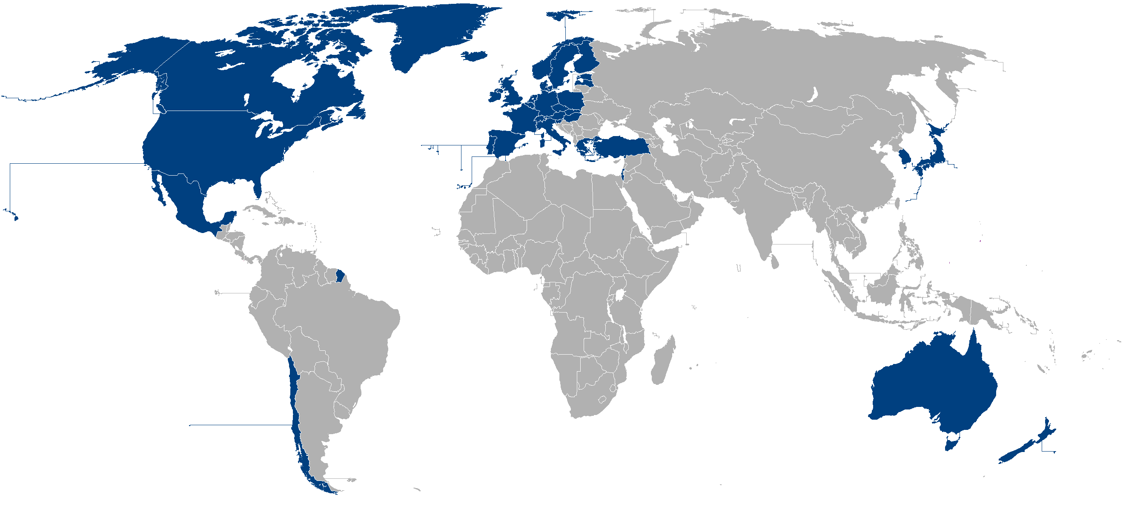
In this analysis I will be comparing the UK to other OECD countries in terms of the GDP expenditure approach.

Slide 3
Documents used within this analysis.
GDP_three_approaches00-21.csv
broadband_and_phone09-21.csv
population_10-19.csv
education_enrolment_age.csv
gdp_quarterly_10-17.csv
pop_employ_10-17.csv
employment_by_industry_10-17.csv
imp_exports_value.csv

